Slide 1



Substrate Dependence and Tunneling Operation of MoS2 Nanotransistors
Arthur Bowman III, Zhixian Zhou
Nanofabrication and Electron Transport Laboratory
Department of Physics and Astronomy

Slide 2
Overview
Motivation
Device Fabrication
Results
Conclusions

Slide 3
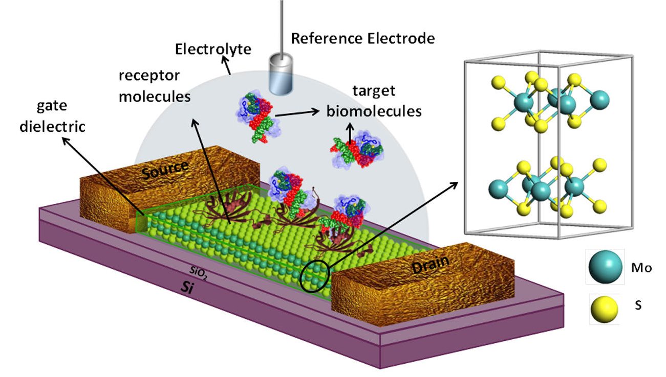
Motivation
Metal Oxide Field Effect Transistors (MOSFETs):
Source → Gate → Channel → Drain
Channel
Source Electrode
Gate Electrode
Drain Electrode
Sarkar et al, ACS Nano (2014)
Electrostatic effects
Quantum Mechanical effects
Understanding them →
Next-generation biosensors
At the Nanoscale:
Oxide Layer
n+
n+
Channel Region
L
P-type Substrate

Slide 4
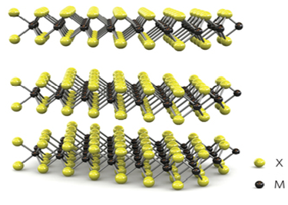
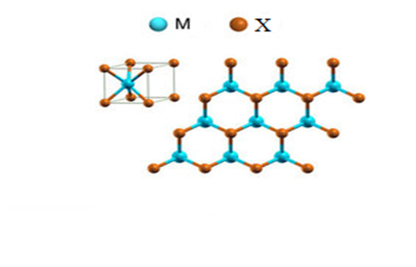
Motivation
Atomically thin, 2 Dimensional Channel Materials
→ Transition Metal Dichalcogenides (TMD)
Hexagonal Layer Structure
Transitional metal
Mo, W, Ti
(d-block elements)
Chalcogen
S, Se, Te
(Oxygen group)
MX₂
e.g. MoS_{2,} MoSe₂ , WS₂, WSe₂ etc.
Chemically stable, flexible and super strong with a reasonable band gap!

Slide 5
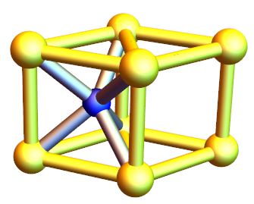
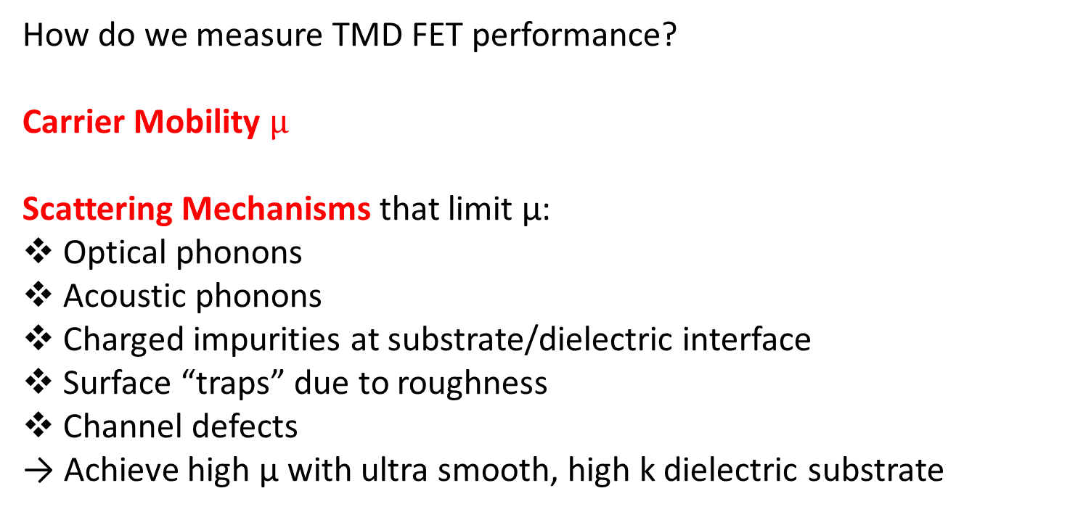
`
Motivation
How do we measure TMD FET performance?
Carrier Mobility $µ$
Scattering Mechanisms that limit µ:
Optical phonons
Acoustic phonons
Charged impurities at substrate/dielectric interface
Surface “traps” due to roughness
Channel defects
→ Achieve high µ with ultra smooth, high k dielectric substrate
1
e-
MoS₂
Intrinsic
Extrinsic
Kis et al. reported µ ~ 60 cm²V⁻¹s⁻¹ at 240 K with high–k dielectric for monolayer MoS_{2.}
(Nature Materials 2013)

Slide 6
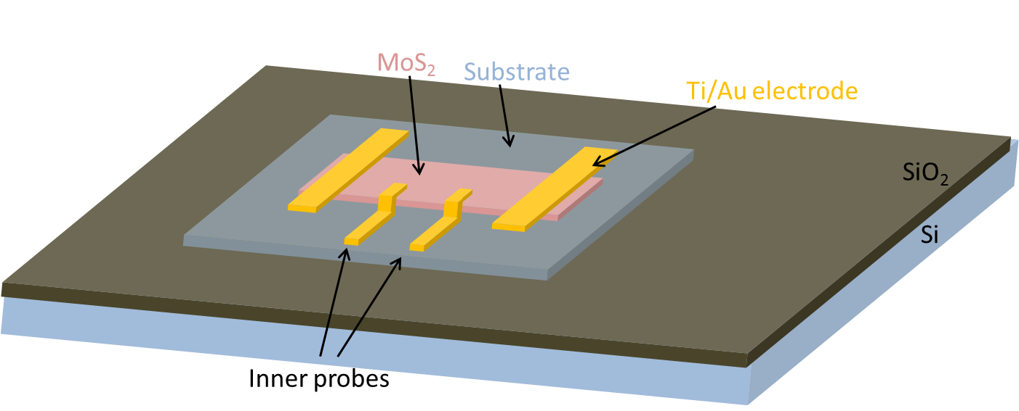
Motivation
Which Substrates Should We Study?
~290 nm clean SiO₂
OTMS SAM treated SiO₂
h-BN
Al₂O₃ on Si/SiO₂
Si/SiO₂ substrates
modified with
OTMS SAMto create a
hydrophobic surface
Higher excitation energy of optical phonons
High dielectric constant
Ultra Smooth Surface
Impurity free
2D layer structure similar to TMD
Atomic Layer Depostion ~60 nm
Higher dielectric constant compared to SiO₂
S
D

Slide 7
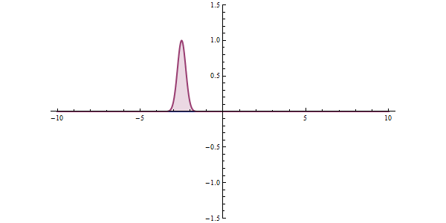
Motivation
Tunnel Field Effect Transistors (TFET)
FET Operation through quantum tunneling
Not much supply voltage needed
→ Low Power Applications
E_{C}
Gate
Fermi Level
E_{G}
Source Fermi Level
MoS₂
MoS₂
P-doped Source
Van Der Waals Gap
Van Der Waals Gap
E_{V}

Slide 8
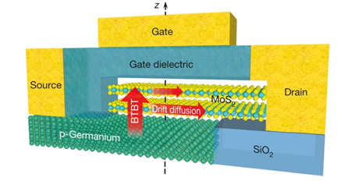
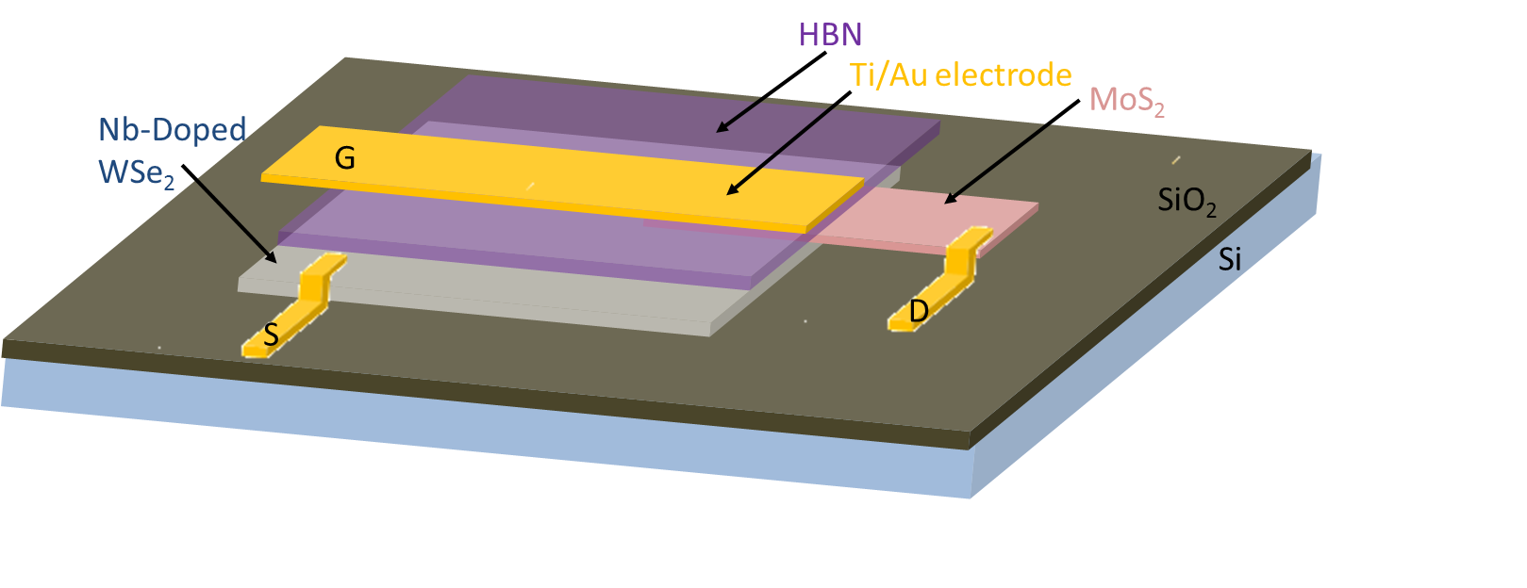
Motivation
How can we improve TFET Performance?
Sarkar et al, Nature (2015)
Subthreshold Swing (SS)
Thermionic limit
→ Achieve High Performance
Subthermionic TFET with
Nb-doped WSe₂ source, Novel Gates

Slide 9
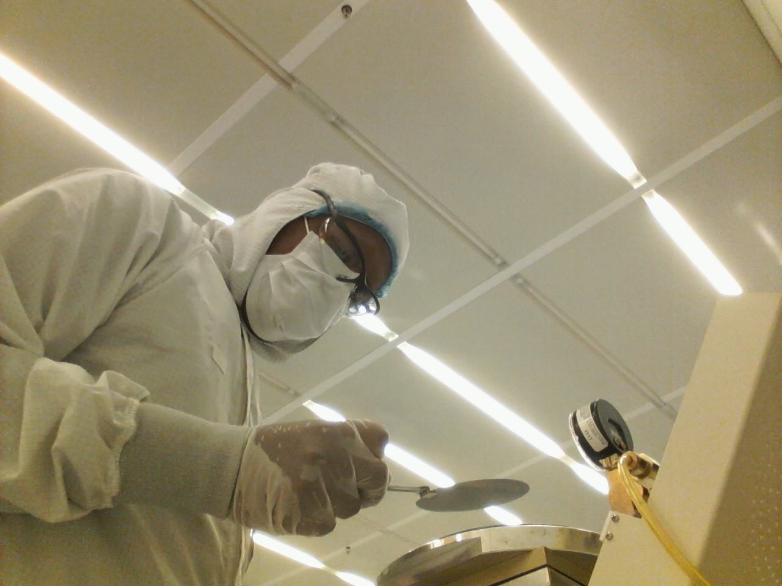
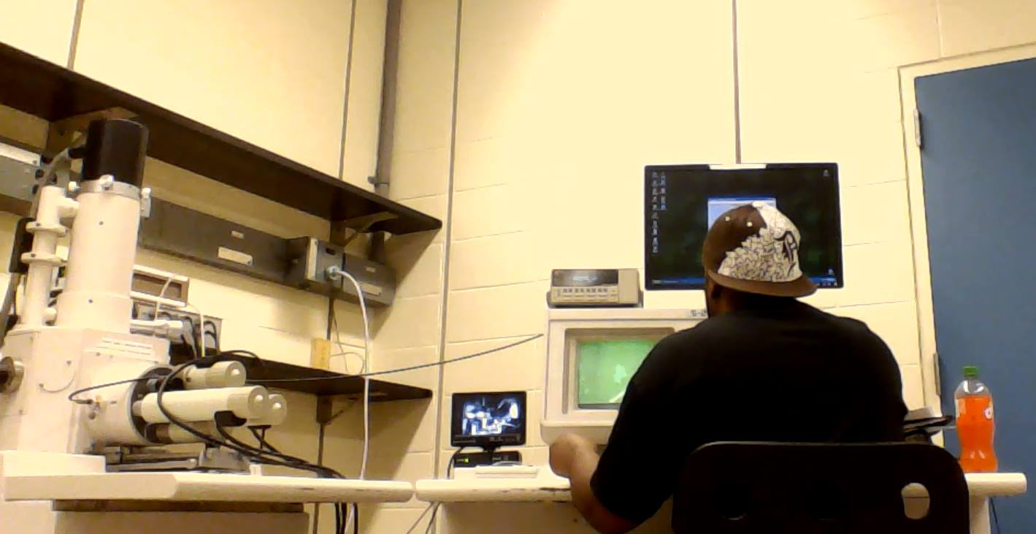
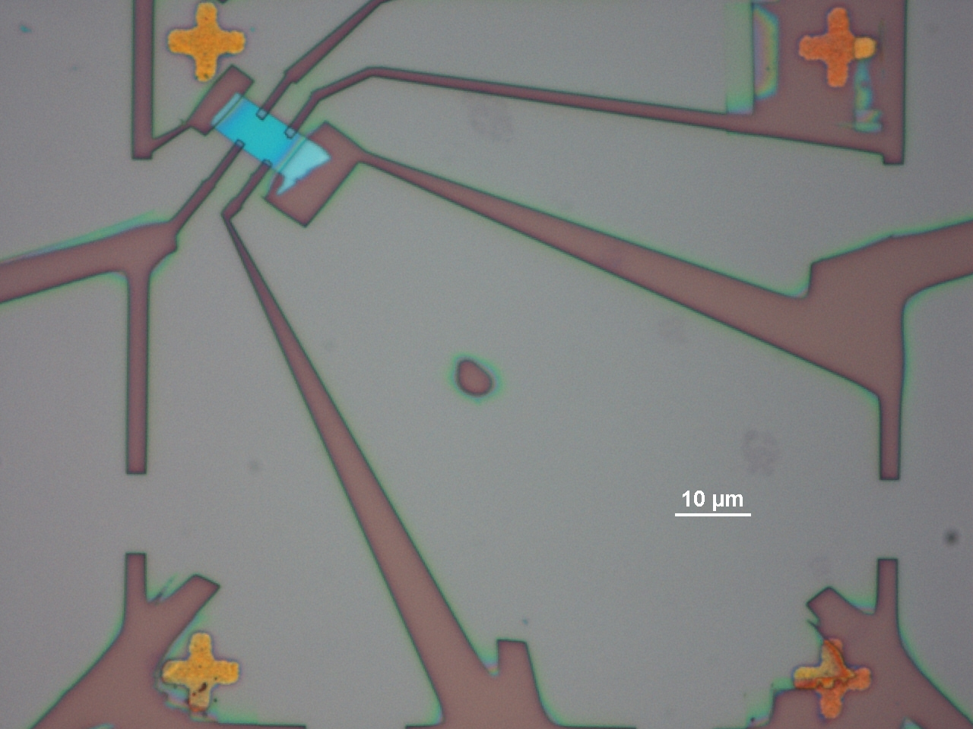
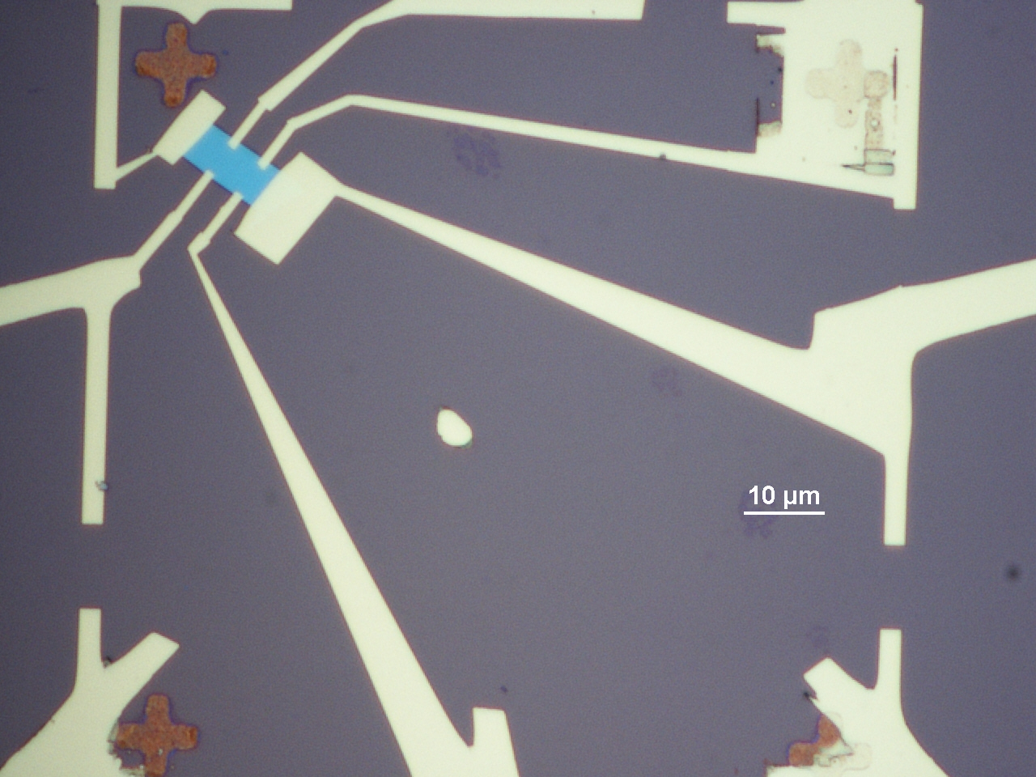
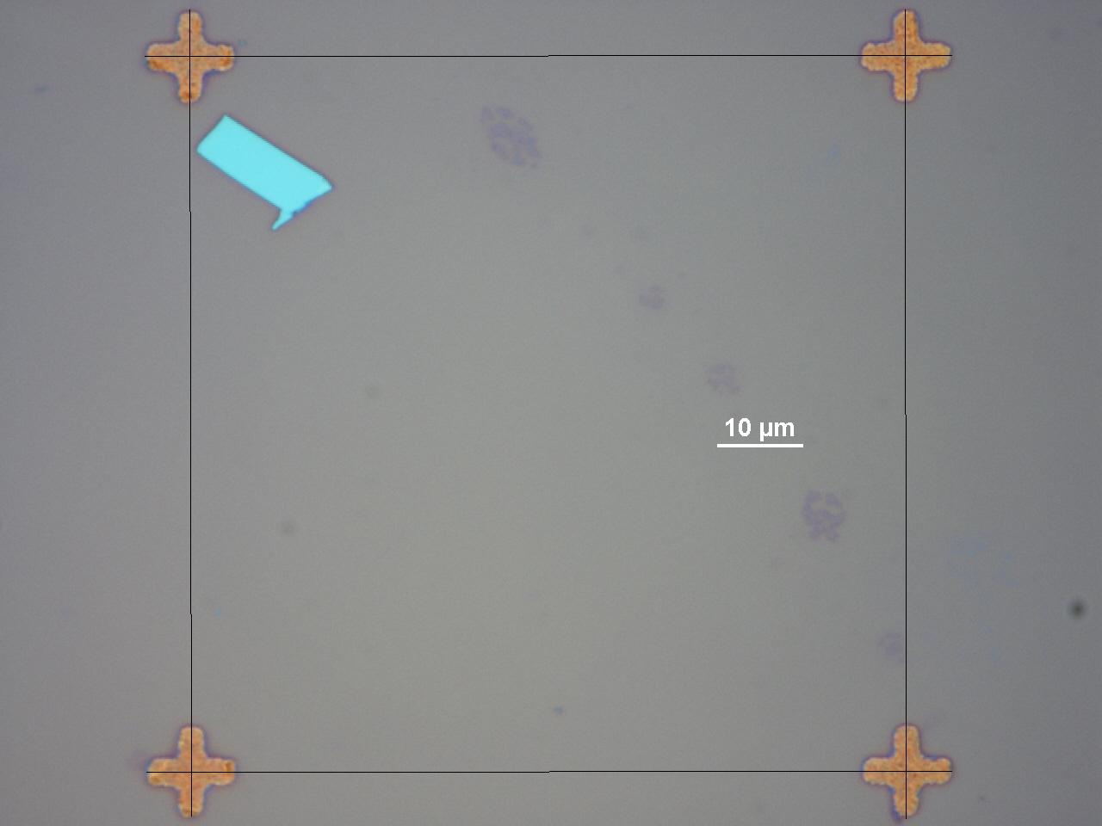
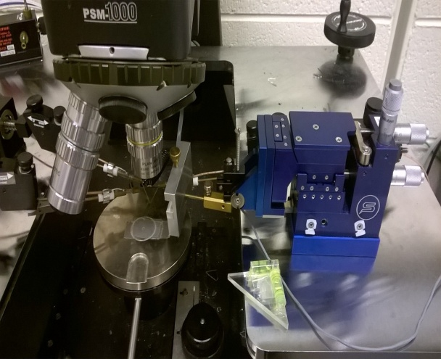
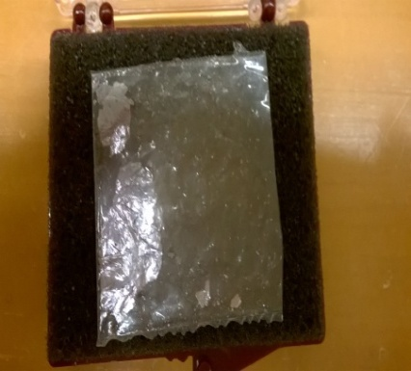
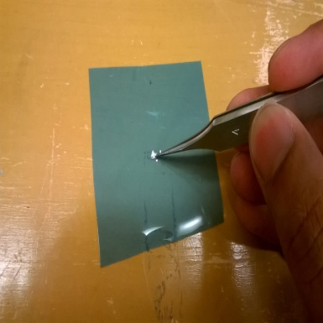
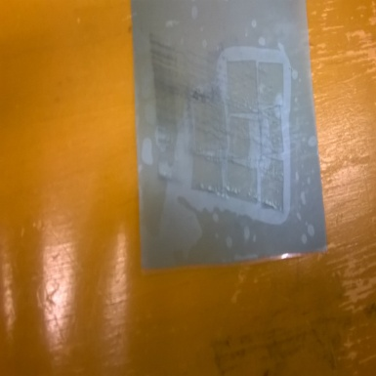
Device Fabrication
Begin with commercial SiO2 on P Type Si Substrate
SiO2
n+
n+
Mechanical Exfoliation of TMD
Transfer onto Substrate
Electron Beam Lithography
Metal Deposition
P-type Si
Liftoff
Transfer stage

Slide 10
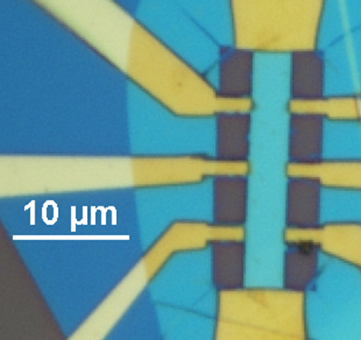
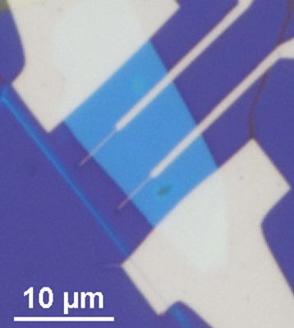
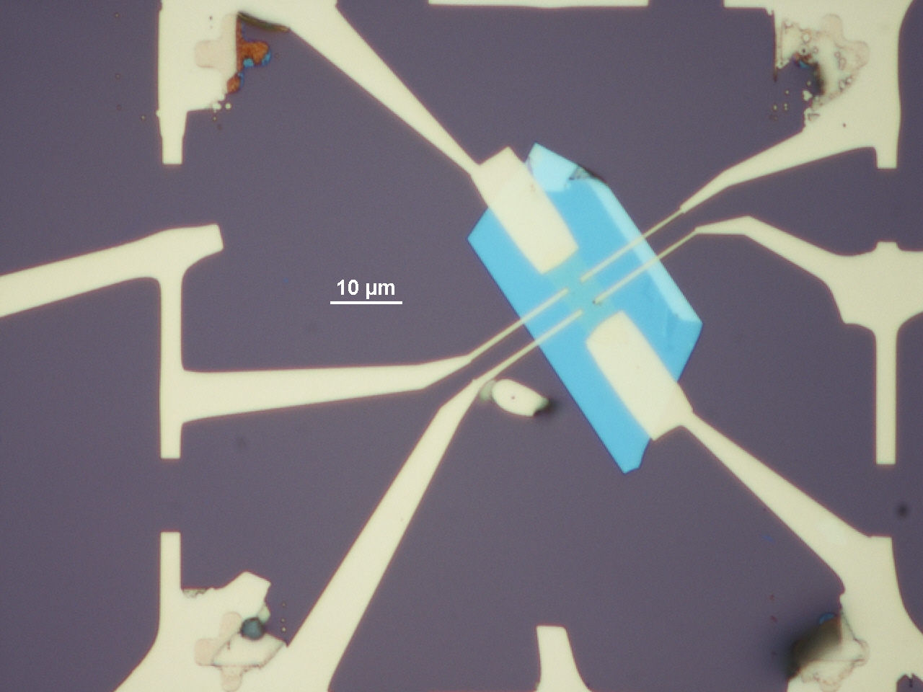
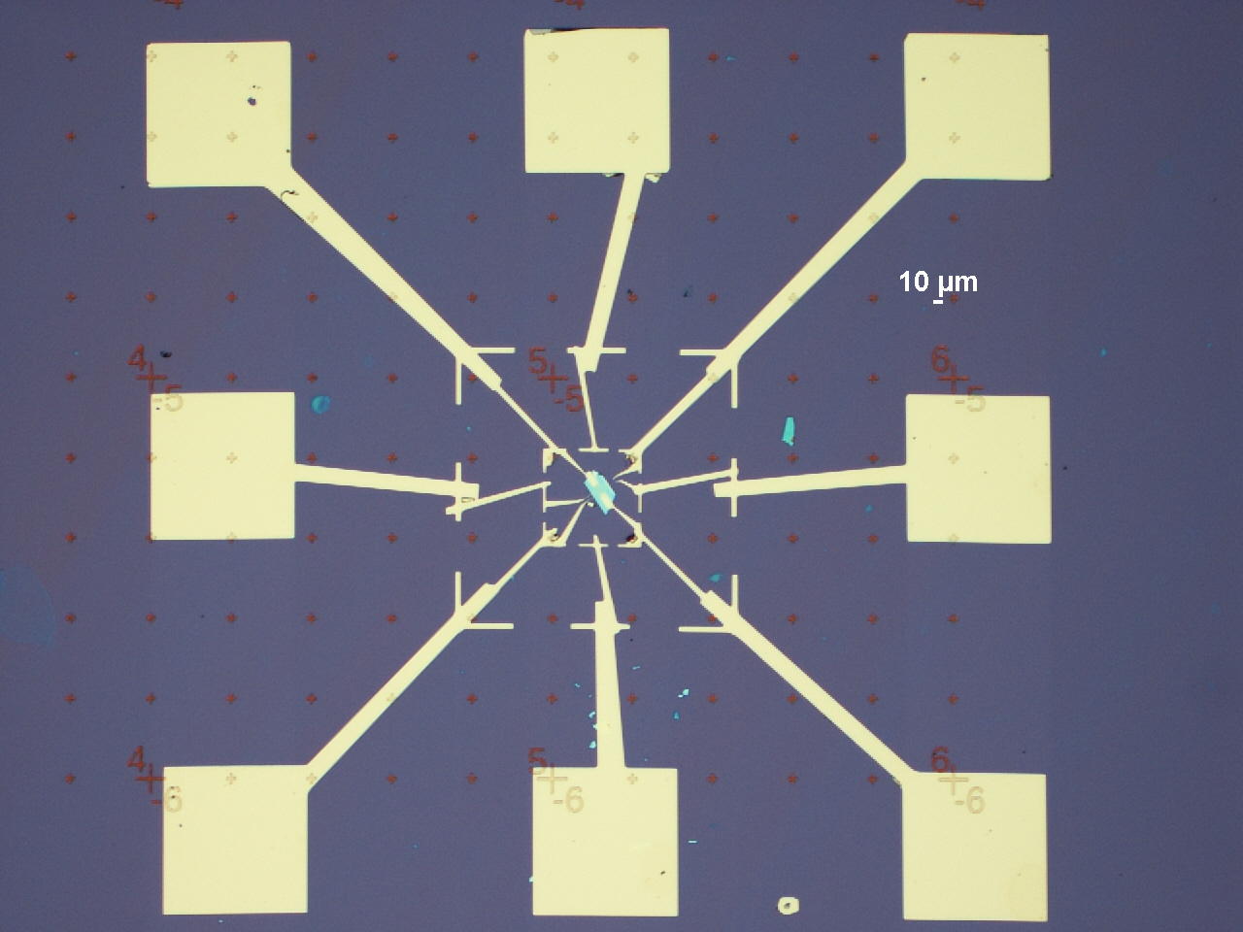
Results
On HBN
On SiO₂

Slide 11
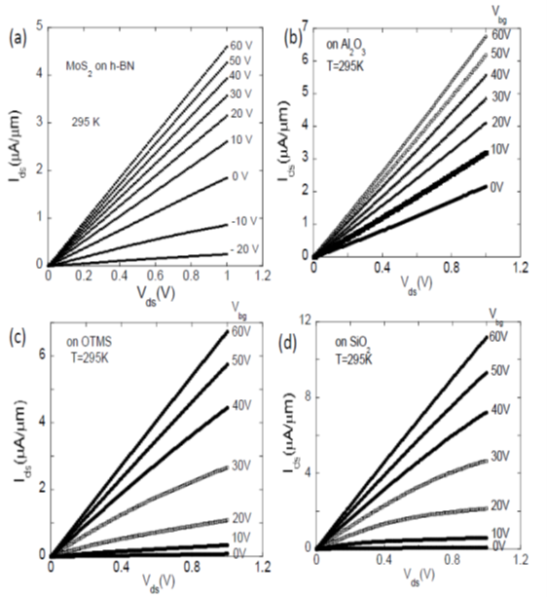
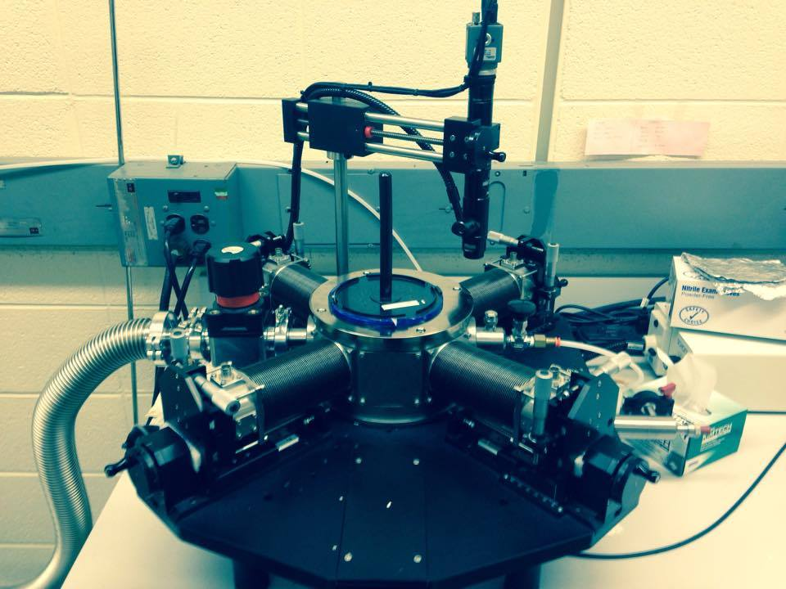
Results
How do we know we’ve made
a good device?
Current Voltage Characteristics (I-V curves)
Ohmic contact on all substrates
HBN looks best

Slide 12
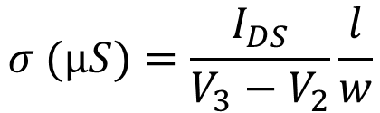
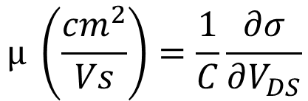
`
Results
Field Effect Mobility
Corresponds to bulk material
I-V curve → Conductivity
→ Field effect mobility, geometric capacitance
h-BN looks best
$$σ (µS)=\frac{I_{DS}}{V_{3}−V_{2}}\frac{l}{w}$$
$$µ \left(\frac{{cm}^{2}}{Vs}\right)=\frac{1}{C}\frac{∂σ}{∂V_{DS}}$$

Slide 13
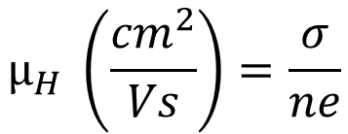
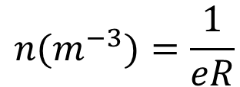
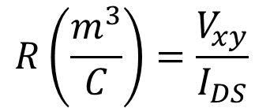
Results
Hall Effect Mobility
Corresponds to bulk + surface material
I-V curve → Hall coefficient
→ carrier density
→ (along with conductivity) Hall mobility
Agrees well with field effect mobility
on h-BN
$$R\left(\frac{m^{3}}{C}\right)=\frac{V_{xy}}{I_{DS}}$$
$$n(m^{−3})=\frac{1}{eR}$$
$$µ_{H} \left(\frac{{cm}^{2}}{Vs}\right)=\frac{σ}{ne}$$

Slide 14
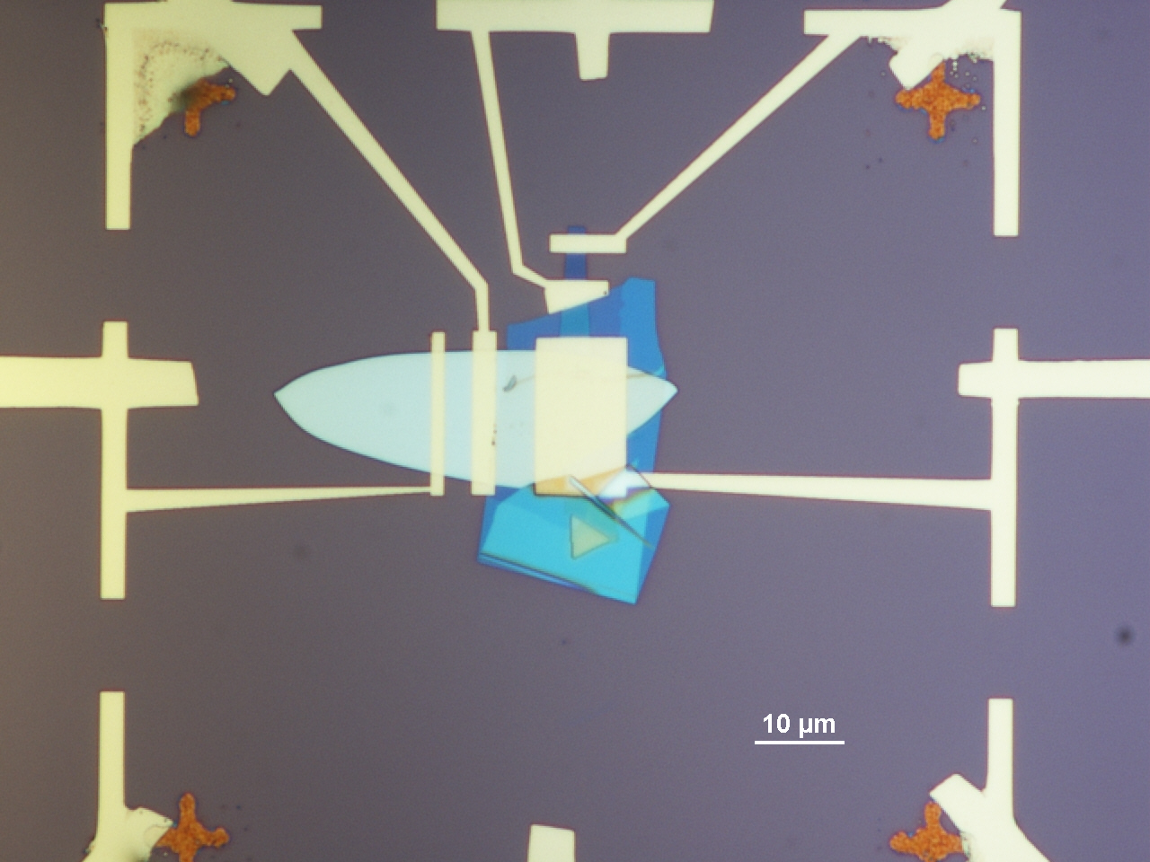
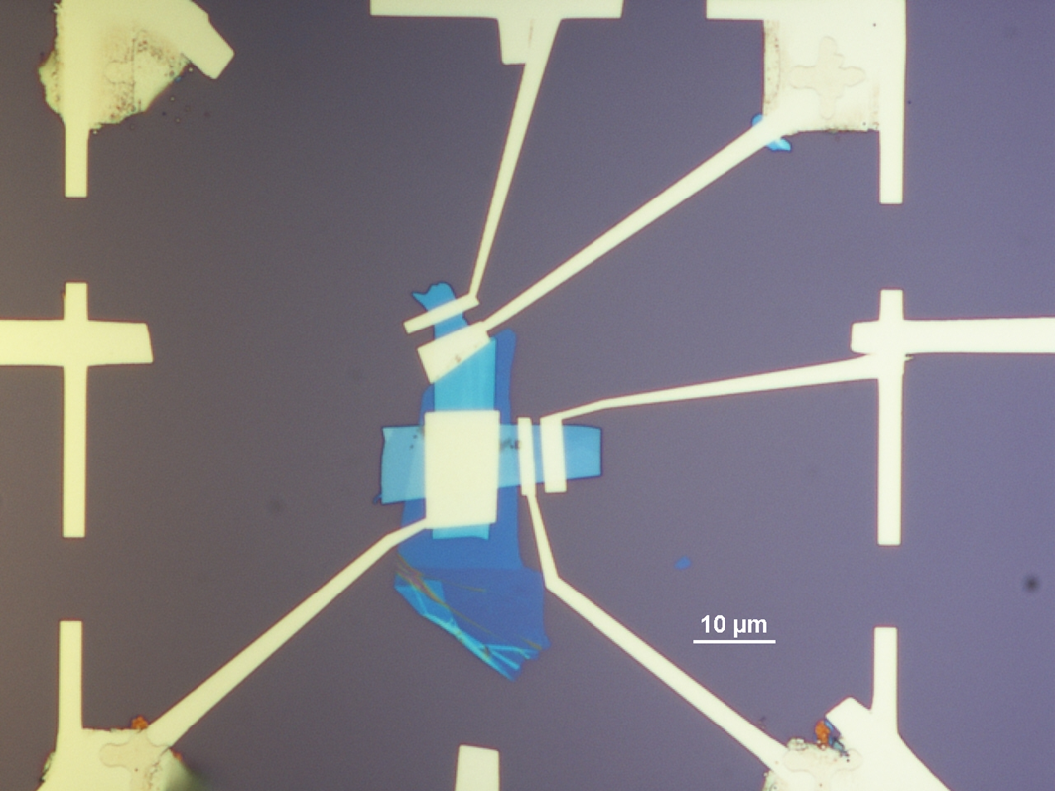
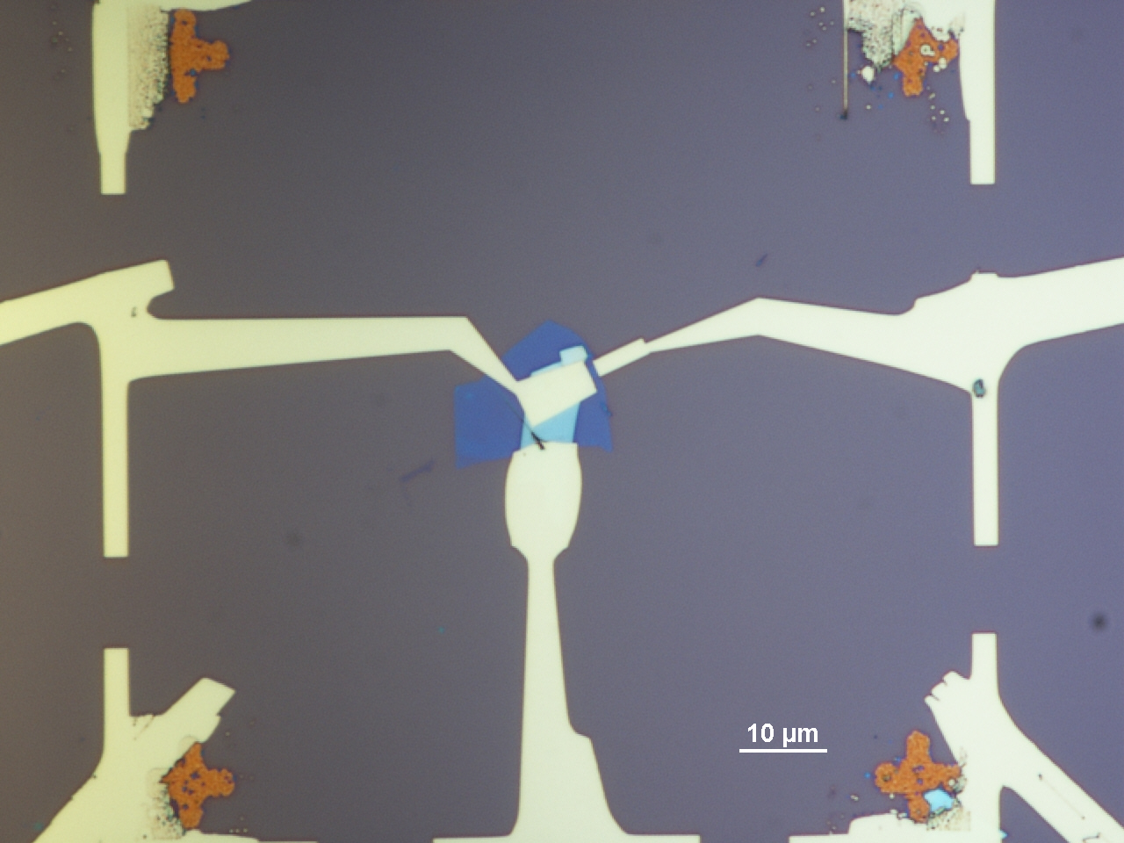
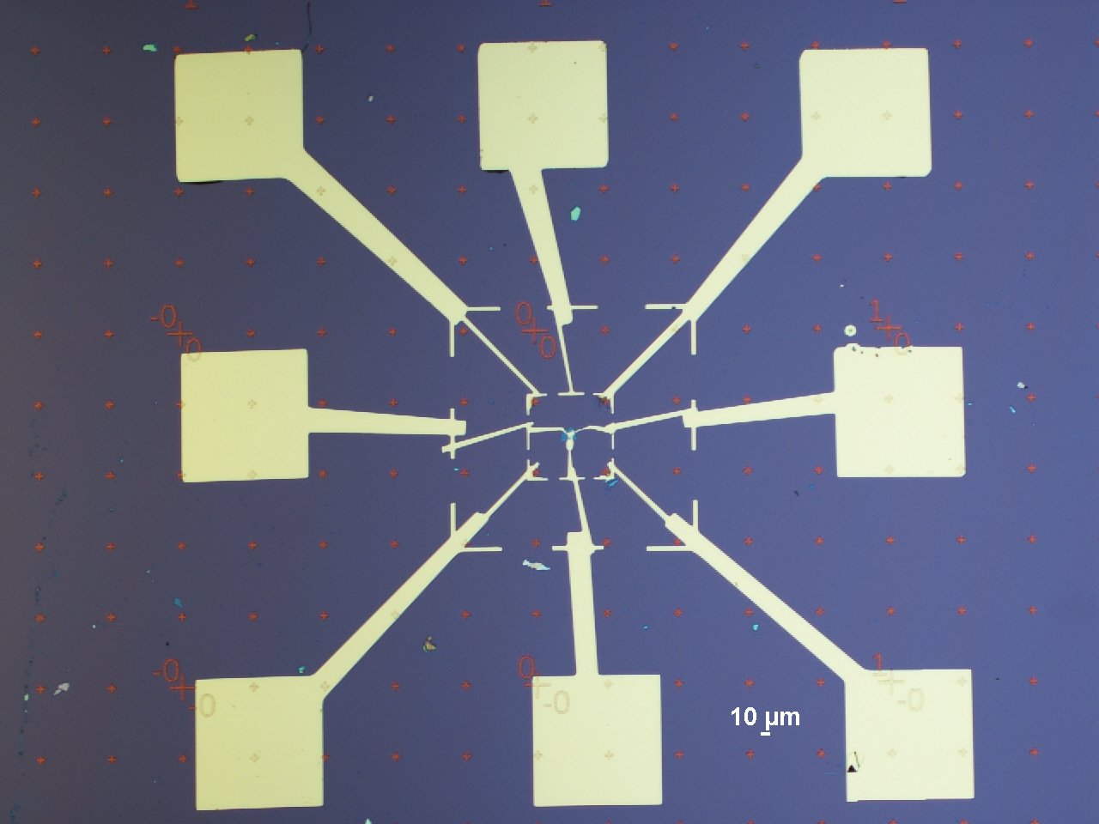
Results
MoS₂
Nb-doped WSe₂
HBN
Junction Area
MoS₂ Channel
Thicknesses:
9 nm
5 nm
2 nm

Slide 15
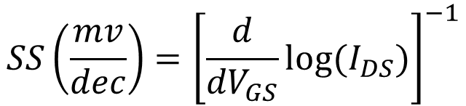
Results
How do we prove tunneling operation?
3 nm
9 nm
Gate Dependence
TFET channel thickness 9 nm:
SS = 147 mv/decade
Channel thickness 2.3 nm:
SS = 110 mv/decade
Still above thermionic limit with HBN gate
Subthreshold Slope
$$SS\left(\frac{mv}{dec}\right)={\left[\frac{d}{{dV}_{GS}}log⁡(I_{DS})\right]}^{−1}$$

Slide 16
Conclusions
Substrate Dependence
Tunneling Operation
Optical-phonon scattering remains dominant below ~ 100 K on h-BN
On all other substrates extrinsic scattering mechanisms start to degrade the carrier mobility below ~ 200 K
The ultra-smoothness and high k environment of h-BN improves mobility
Subthreshold Swing of 0.05 % Nb-doped WSe₂/ MoS₂/h-BN devices were still above thermionic limit of 60 mv/decade
This could be due to intrinsic limitations of h-BN gates or non ideal fabrication
More h-BN gated devices, experiments with other gate materials needed
IN THE FUTURE: PHASE-ENGINEERED DIELECTRICS
IN THE FUTURE: IONIC LIQUID GATING, BV DOPING

Slide 17



Acknowledgements
The authors would like to acknowledge:
Nanofabrication and Electron Transport Labortatory Senior Students:
Hsun Jen Chuang, Bhim P. Chamlagain, Meeghage M. Perera
Wayne State Universtiy nFab core facility staff:
William Funk, Dan Durisin
Initiative for Maximizing Student Development (IMSD) Program
National Institute of Health
For making this research possible

